Slide 1


Presented by Ahmad Alsallaq
Exploratory Data Analysis (EDA) of Job Postings in the Middle East

Slide 2

Overview of the Dataset
Dataset size: 2500 job postings
Columns: 5 features including Job Title, Company, Location, Description, skills.
Goal: Provide insights into the job market in the Middle East

Slide 3

Missing Values
Fields with Missing Data:
Title: 1 missing value
Company: 187 missing values
Location: 7 missing values
Description 1 missing value
Skills 1 missing value

Slide 4
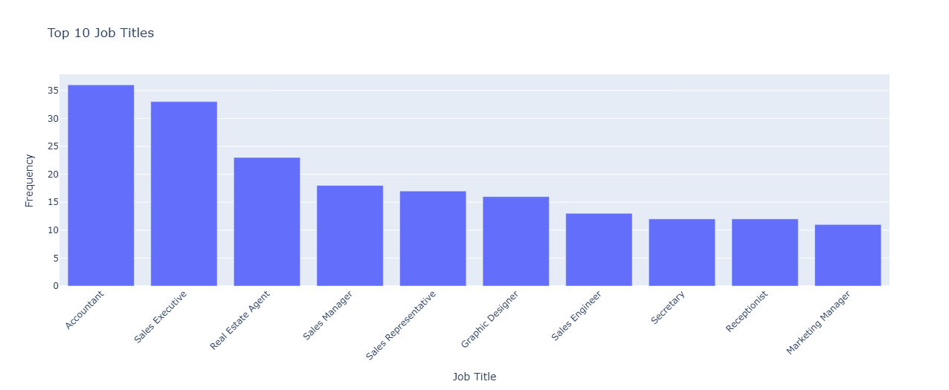
Summary Statistics - Categorical Data

Slide 5
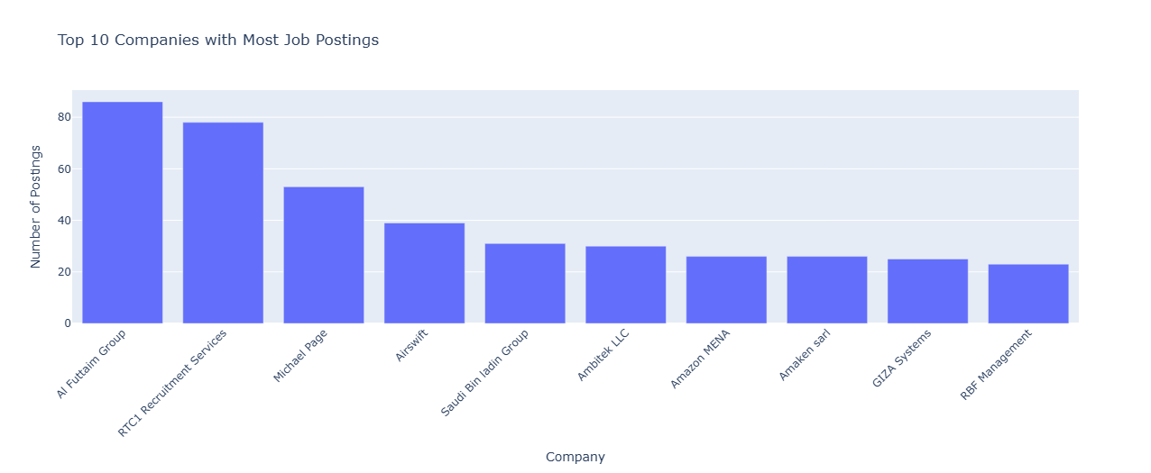
Summary Statistics - Categorical Data

Slide 6
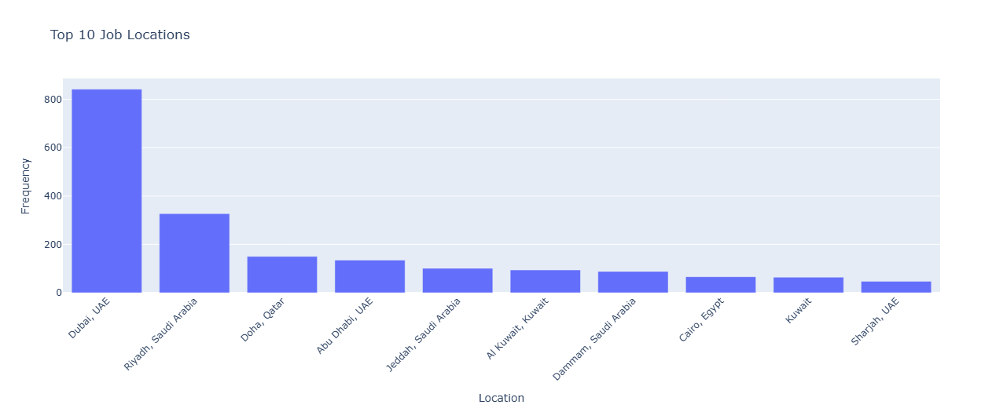
Summary Statistics - Categorical Data

Slide 7
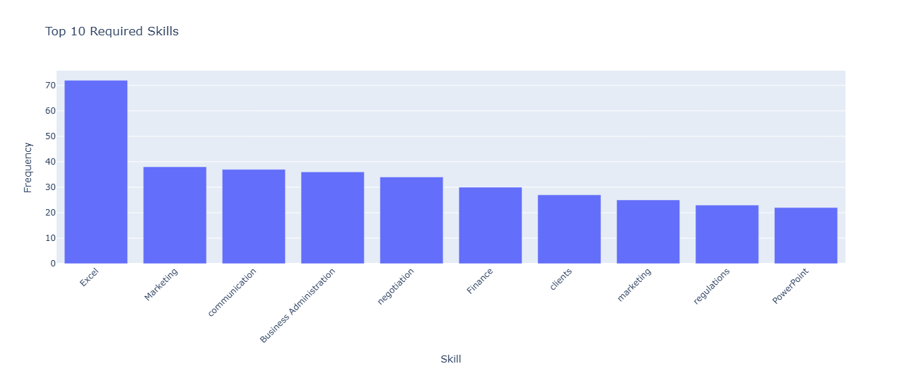
Summary Statistics - Categorical Data

Slide 8
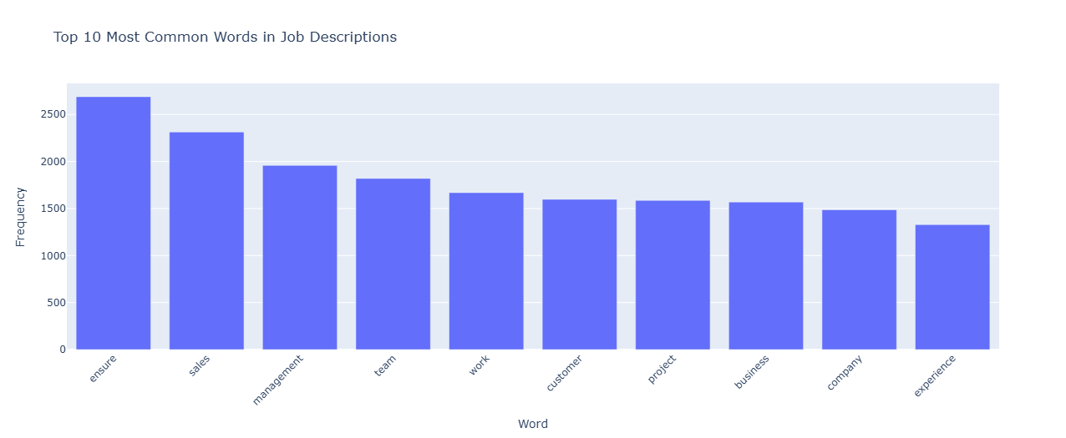
Summary Statistics - Categorical Data

Slide 9

Categorical Analysis
Most Common Job Titles:
Accountant, Sales Executive, Real Estate Agent
Top Employers:
Al-Futtaim Group, RTC1 Recruitment Services, Michael page
Popular Locations:
Dubai - (UAE), Riyadh - (KSA), Doha - (Qatar)

Slide 10
Textual Analysis
Job Descriptions:
Top Keywords: ensure, sales, management
Description with the most words: 1182
Average word count: 164.34
Count 2499
Skills:
Top Keywords: Excel, Marketing, communication
Skills with the most words: 502
Average word count: 66.15
Count 2499

Slide 11
Key Insights
Job Opportunities: Sales roles lead, with positions like "Sales Executive" and "Sales Manager" among the top. Managerial roles make up 4 of the top 10 titles.
Location Distribution: Most jobs are in the Gulf region, especially Dubai (842 postings) and Riyadh (327).
Industry Diversity: Sales, development, and administration dominate, with smaller representation from the food industry.

Slide 12

Conclusion
Overall Insights: This EDA highlights missing data challenges, the concentration of jobs in key cities, and the diversity of roles across industries in the Middle East.

Slide 13

Presented by Ahmad Alsallaq
Thank you very much!

